Slide 1
CS19P11 - INTERNET OF THINGS ESSENTIALS
AUTOMATED DUSTBIN
SYSTEM
Mr. S.Suresh Kumar M.E.,(Ph.D.)
- AKALYA G (210701021)
- AKSHITHAA B K (210701024)
- AMIRDHA M (210701026)

Slide 2
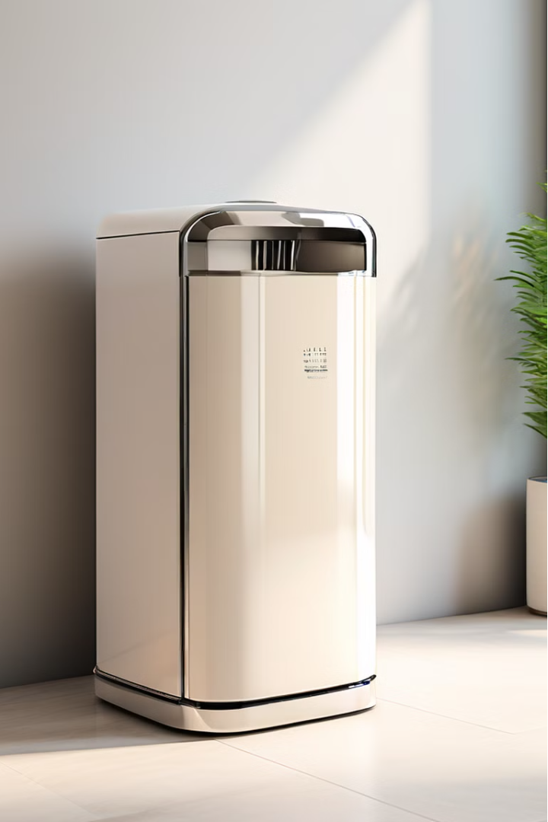
Introduction to the Automated Dustbin System
The Automated Dustbin System is an innovative waste management solution that utilizes advanced sensor technology to enhance efficiency and convenience. By integrating an ultrasonic sensor, the system automatically detects nearby objects and responds by opening the dustbin lid, streamlining the waste disposal process.

Slide 3
Objectives of the Automated Dustbin System
Hands-Free Convenience
Improved Hygiene
Enhanced Efficiency
The system eliminates the need for manual lid opening, allowing users to simply approach the dustbin and discard waste without interruption.
By automating the lid movement, the system reduces the spread of germs and promotes a more sanitary waste disposal environment.
The automated mechanism ensures the lid is open only when necessary, optimizing the disposal process and minimizing energy consumption.

Slide 4
Ultrasonic Sensor Technology for Object Detection
1
Precision Sensing
2
Reliable Performance
The ultrasonic sensor accurately detects the presence of objects within a defined range, triggering the lid opening mechanism.
Ultrasonic technology provides a robust and reliable solution for object detection, ensuring consistent and dependable operation.
3
Versatile Deployment
4
Energy-Efficient Design
The sensor can be strategically positioned to cover the desired area, adapting to various dustbin sizes and environments.
The low-power ultrasonic sensor minimizes energy consumption, contributing to the system's overall energy-efficient performance.

Slide 5

Automated Lid Opening and Closing Mechanism
1
Lid Opening
Upon detecting an object within the sensor's range, the system triggers the lid to open automatically, allowing for convenient waste disposal.
2
Lid Closing
Once the object moves away, the lid is programmed to close, maintaining the dustbin's secure and hygienic state.
3
Smooth Operation
The mechanism is designed to operate quietly and smoothly, providing a seamless user experience and reducing mechanical wear over time.

Slide 6




Sensor Range and Triggering Mechanism
Adjustable Range
Rapid Response
Precise Targeting
Delayed Closing
The triggering mechanism is designed to react instantly to the presence of an object, minimizing the time required for the lid to open.
The sensor's directionality and focus ensure accurate object detection, reducing the risk of false triggers or missed detections.
The system incorporates a slight delay in lid closing to allow users ample time to complete their waste disposal tasks.
The sensor's detection range can be customized to suit different dustbin sizes and user preferences, ensuring optimal performance.

Slide 7
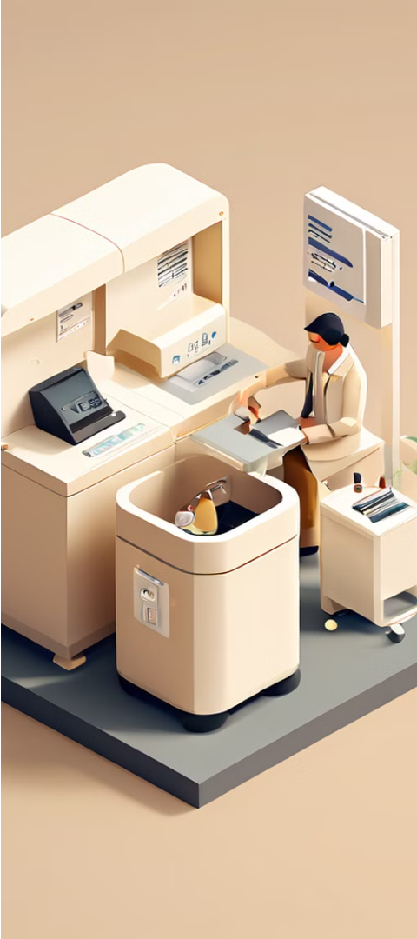



Waste Disposal Efficiency Improvement
Reduced Waste Buildup
The automated lid opening ensures waste is promptly and consistently disposed of, preventing the accumulation of refuse.
Optimized Waste Handling
The system's efficiency allows for more frequent waste collection and disposal, maintaining a cleaner and more hygienic environment.
Enhanced User Experience
The seamless and convenient waste disposal process encourages users to adopt the system, further improving overall efficiency.

Slide 8
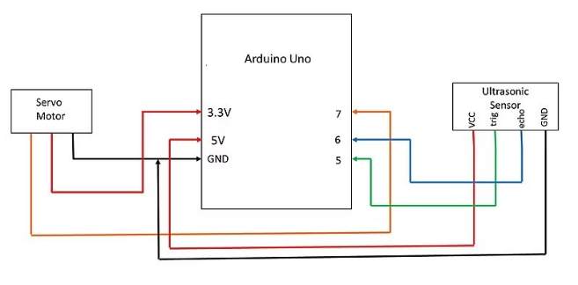
CIRCUIT DIAGRAM:

Slide 9
System Integration and Components
Ultrasonic Sensor
Detects the presence of objects and triggers the lid opening mechanism.
Microcontroller
Processes the sensor data and controls the automated lid operation.
Lid Actuator
Responsible for the smooth and quiet opening and closing of the dustbin lid.
Power Supply
Provides the necessary power to the system, ensuring reliable and uninterrupted operation.

Slide 10
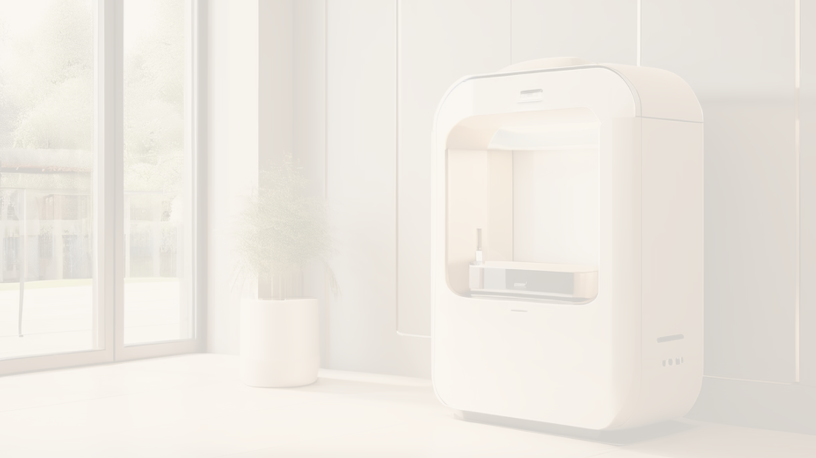
Conclusion and Future Enhancements
Conclusion
Future Enhancements
Positive Impact
The Automated Dustbin System, powered by ultrasonic sensor technology, offers a innovative and efficient solution to waste management, delivering hands-free convenience and improved hygiene.
The system's automated features and efficient waste disposal process contribute to a cleaner, more sustainable environment, making it a valuable asset for both residential and commercial applications.
Potential future enhancements may include integration with smart home systems, the ability to monitor waste levels, and the incorporation of recycling capabilities.

